Slide 1
GRAJENJE ODNOSOV
V DIGITALNEM SVETU
Jasna Klemenc Puntar

Slide 2
Kdaj ste se nazadnje pogooglali?

Slide 3
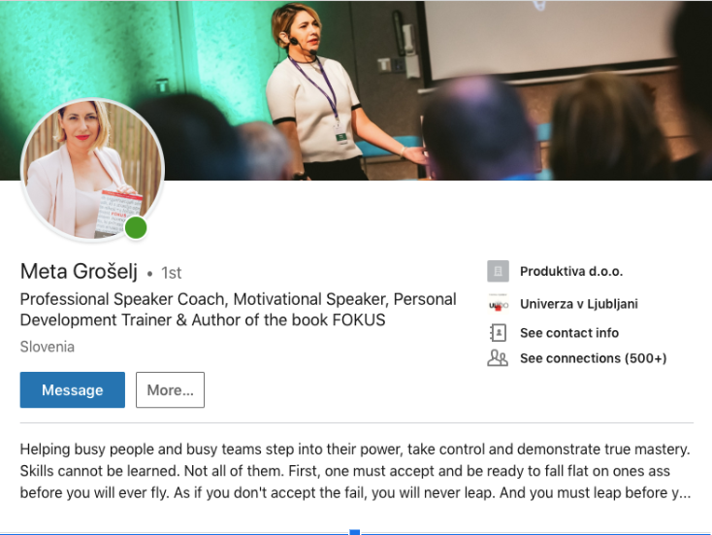
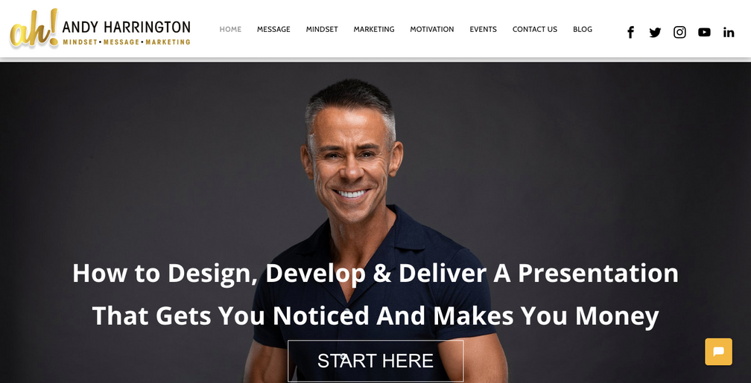
Notes:
I would like to tell you a story about WHY making your first impression online matters a lot.
Meta was an internationally accredited professional speaker coach. She used to coach at Andy Harrigton's The Professional Speakers Academy where the world’s very best speakers are trained.
So Meta decided one day that she would want to coach TEDx speakers at a TEDx local event.
This is usually a pro bono service but gives a great exposure to the coach. It's a sign of prestige.
She reached out to local TEDx organizers to set up a meeting with them.
Before she attended the meeting she connected with a person she was supposed to meet on LinkedIn.
And after that, he canceled their meeting.
What happened here?

Slide 4
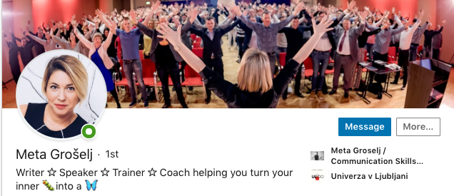
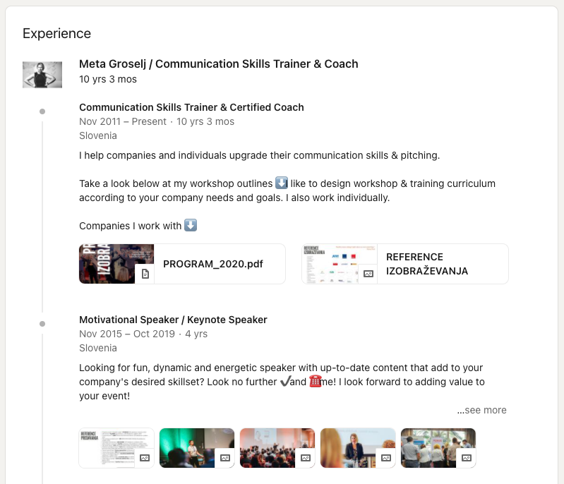
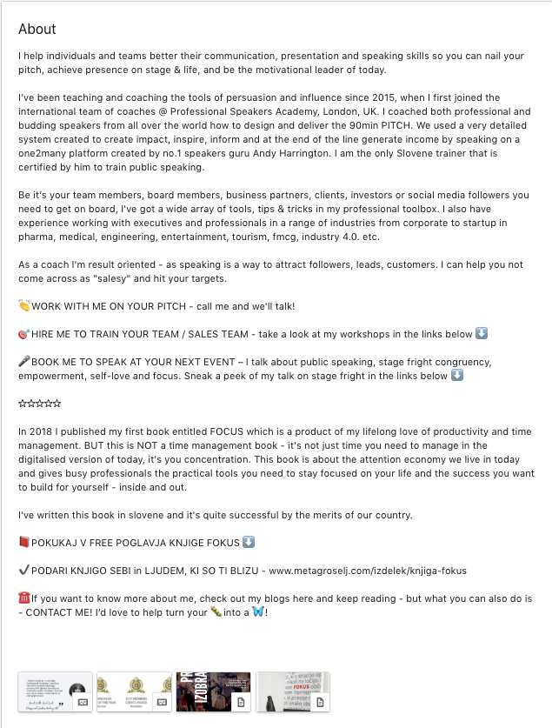
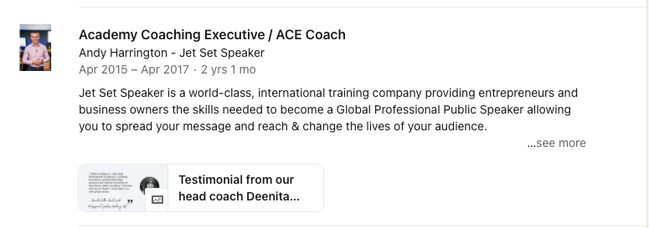
Notes:
In one of my LinkedIn Masterclasses Meta learned that her LinkedIn profile was not optimized properly and gave the wrong impression to TEDx organizers.
She was lacking social proof and clarity. She did not even mention Andy Harrington's experience on her profile.
That has changed and Meta has built a strong profile showing her expertise.

Slide 5
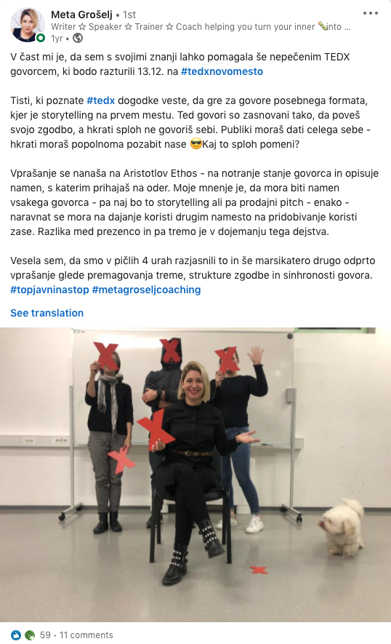
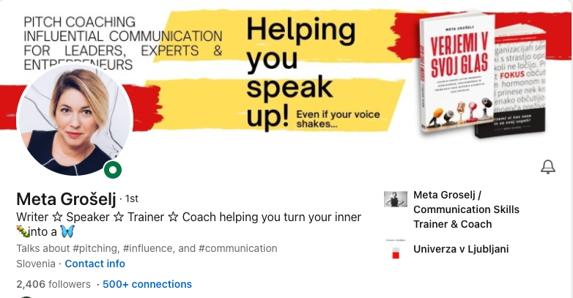
Notes:
A few months after her profile update - organizers from another local TEDx event reached out to her if she can help their speakers.
Meta was lucky - since she learned quickly that something was wrong with her online identity and she was able to fix it.
You may not be so lucky. People will google you, make wrong conclusions and your opportunities will be lost forever.
That's why we will be covering your minimum viable personal LinkedIn profile today.
If you set up your profile right - your personal profile will appear on the top of your search results when people google your name.

Slide 6
IMAMO SAMO ENO PRILOŽNOST, DA NAREDIMO PRVI VTIS.

Slide 7
1 povezava, 1 napotilo, 1 komentar ali 1 objava je lahko dovolj, da pridemo do velike priložnosti!
Ampak imamo samo eno PRILOŽNOST,
da naredimo prvi vtis!
Notes:
Remember
1 connection, 1 referral, 1 comment, or 1 post
can be enough to land a MAJOR OPPORTUNITY!
But you only have 1 OPPORTUNITY
to make your 1st impression!

Slide 8
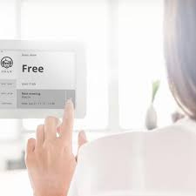
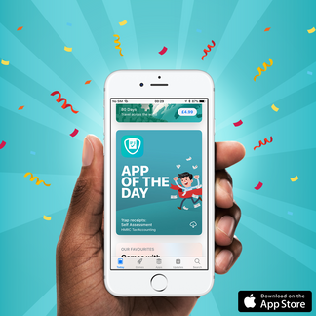
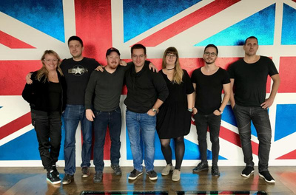
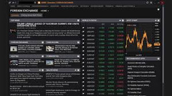
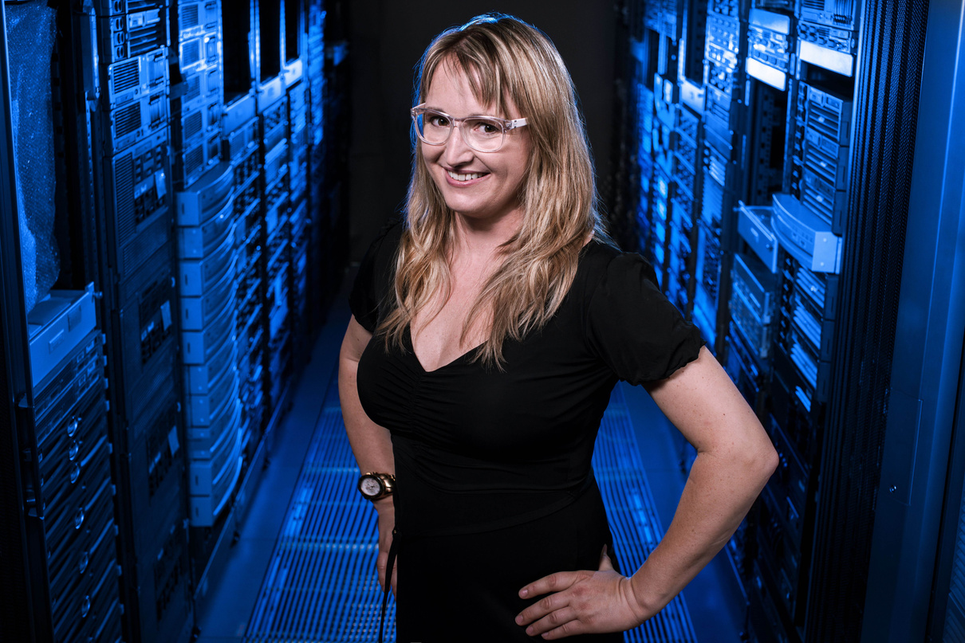
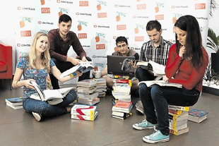
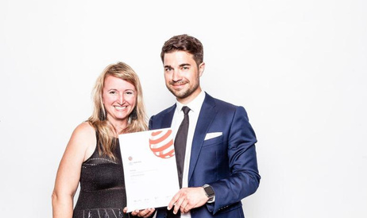
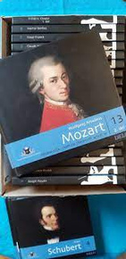
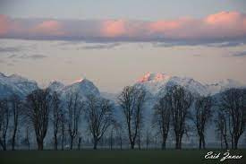
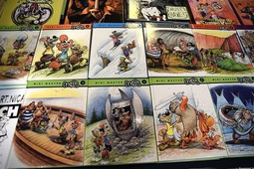
Zelo veliko časa nazaj
V bližnji preteklosti
PRODUKT - TRGI - OPERACIJE
Notes:
Before we dive deeper - a few things about me.
I was born and raised in Slovenia and studied in the US, Florida.
I currently live in the suburbs in Slovenia, under the Alps, half an hour away from the ski slopes, and a 1h drive from the seaside.
I love skiing and sailing.
My first job was in foreign exchange and I stayed in banking for almost a decade.
From a corporate world of publishing and software development, I went to work for startups. That was a bold move since I had 2 small kids but I never regretted this experience.

Slide 9
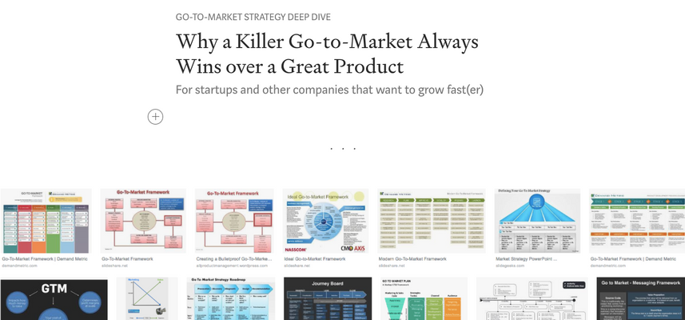
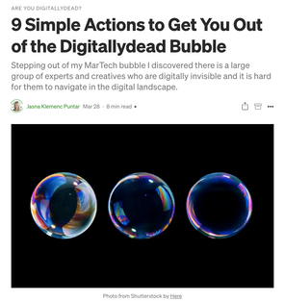
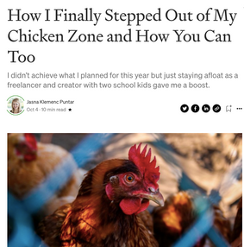
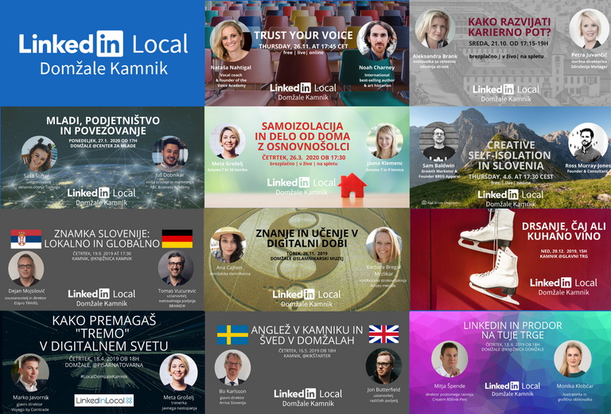
STROKOVANJAKINJA ZA E-MREŽENJE, LINKEDIN INŠTRUKTORICA, COACH IN MENTOR ZA PRIHOD NA TRG
20+ cohorts of
E-networking & professional online identity
Te dni
6.-16. junij 2022
10+ early stage startups - coaching on going-to-market
Master E-networking
Channel marketing
How to reverse engineer other LinkedIn profiles
to position yourself as an expert
Notes:
When I started freelancing I wrote a deep dive on going-to-market that happens to be one the most highlighted articles on Medium.
LinkedIn has always been my favorite social media network.
I started to organize #LinkedInLocal, a series of social networking events to meet more people like me who are working globally in the suburbs.
I also created a 6-week masterclass and coached more than 100+ people on how to build their professional identity online and start building their network.
Last year I was super lucky to get invited to a 3rd Maven cohort of instructors and I launched my 1st cohort there on social networking on LinkedIn this December.
The 2nd cohort will be this April
2022.
I want you to remember the April 12 date! Mark it down in your notes. 12.4.2022
If you come, I will teach together with other students to master digital relationship-building in a week.

Slide 10
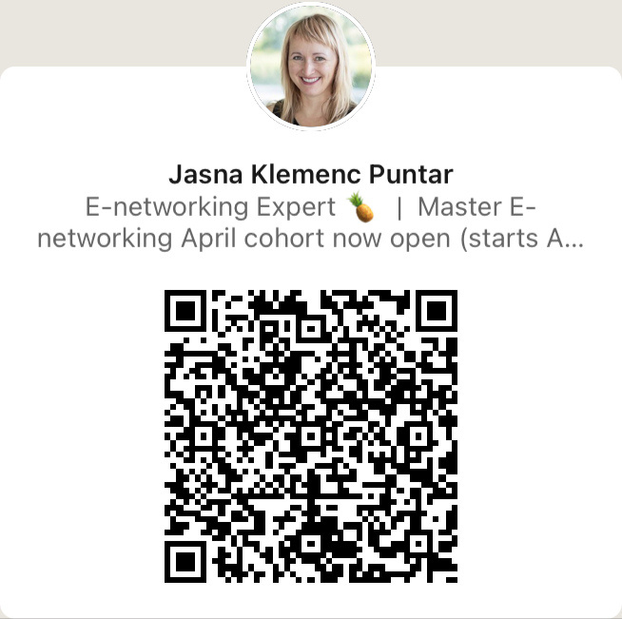
HITRA VAJA
2 min
V ŽIVO
Povežite se s sosedom na LinkedInu ali na drugem družbenem omrežju!
VIRTUALNO
Predstavite se v klepetu in dodajte svoj profil(-e) za povezavo!

Slide 11
E-mreženje
Spoznavanje in grajenje odnosa z ljudmi digitalno,
še preden jih srečamo
v živo ali na video klicu (Zoomu).
#jasnaio

Slide 12
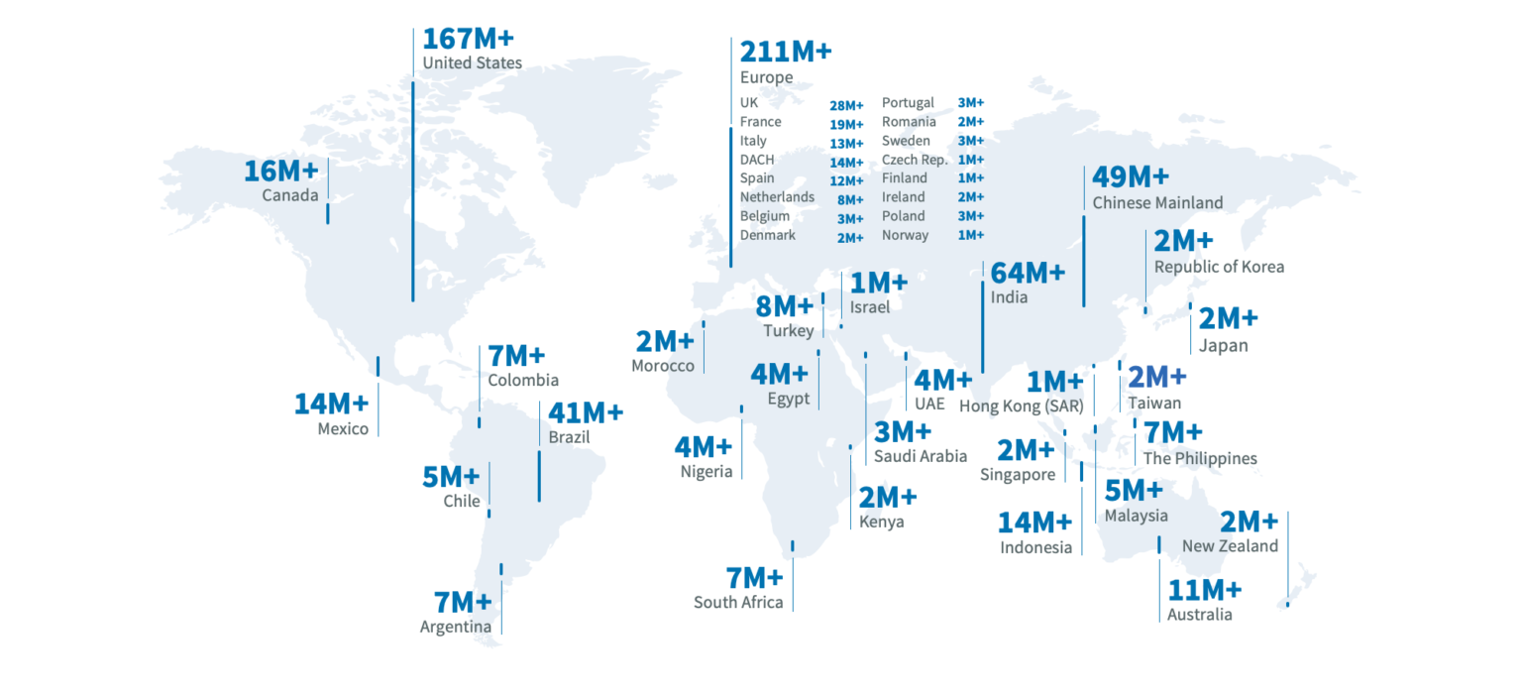
LinkedIn je največji dogodek e-mreženja.

Slide 13
"Prijatelji od prijateljev" so pomembni na LinkedInu.
BREZPLAČNO
1.stopnja povezave
100
BREZPLAČN0
2. stopnja povezave
10.000
PLAČLJIVO
Ocenjena 3. stopnja povezave
1.000.000
#jasnaio
Notes:
You can have 1st degree, 2nd degree, or 3rd-degree connections on LinkedIn.
1st-degree are folks that you're connected to.
When you connect with someone - all their connections become your 2nd-degree connections.
Most of the business on LinkedIn happens in the so-called Friends of a friend zone.
People that you have not met but you can reach out to them for free - your 2nd-degree connections.
Your job on LinkedIn is to expand your friend of a friend zone by connecting with people - to get more opportunities.

Slide 14
Grajenje odnosov zdaj poteka NAJPREJ v digitalnem svetu.
1. korak
2. korak
3.korak
4. korak
"MVP"
PROFIL
DIREKTNA SPOROČILA
DRUŽBENI DOKAZ
DOGODEK "BOOSTER"
www.masterenetworking.com

Slide 15
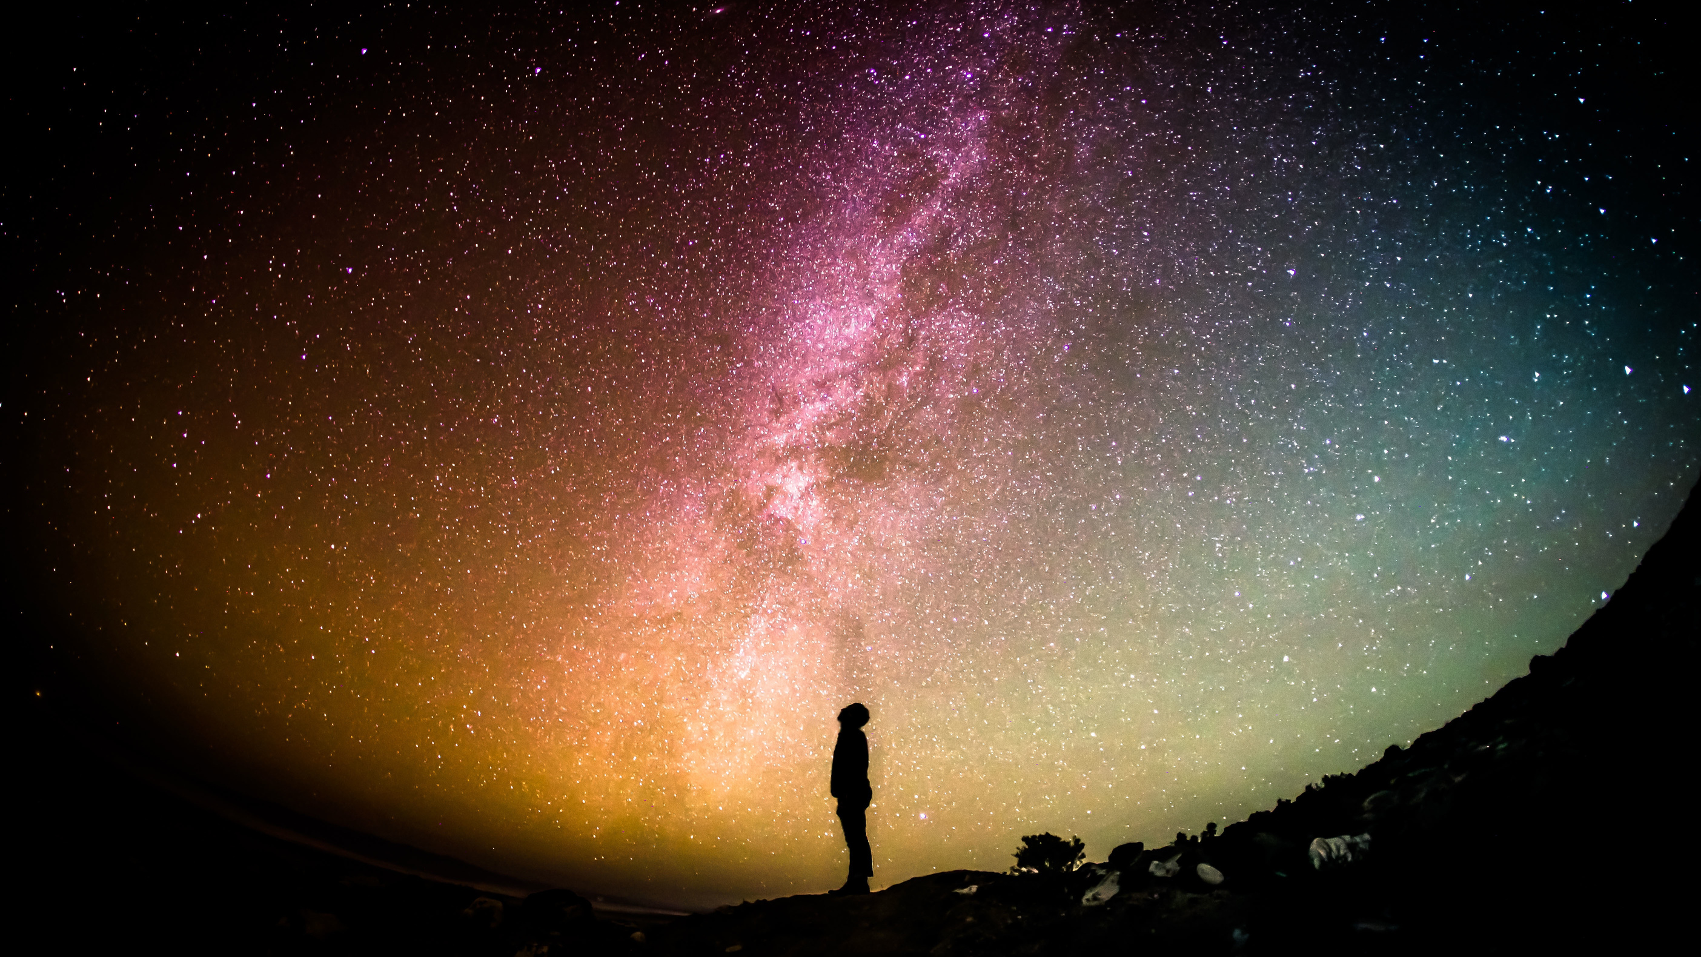
Še nikoli nismo imeli takšne priložnosti, da se povežemo
z isto-mislečimi ali zanimivimi ljudmi iz celega sveta.
#jasnaio
Notes:
We never had such an opportunity to connect with like-minded or interesting people from the whole world.
I hope you find new connections in 2022 that will bring you new opportunities and open new horizons.

Slide 16
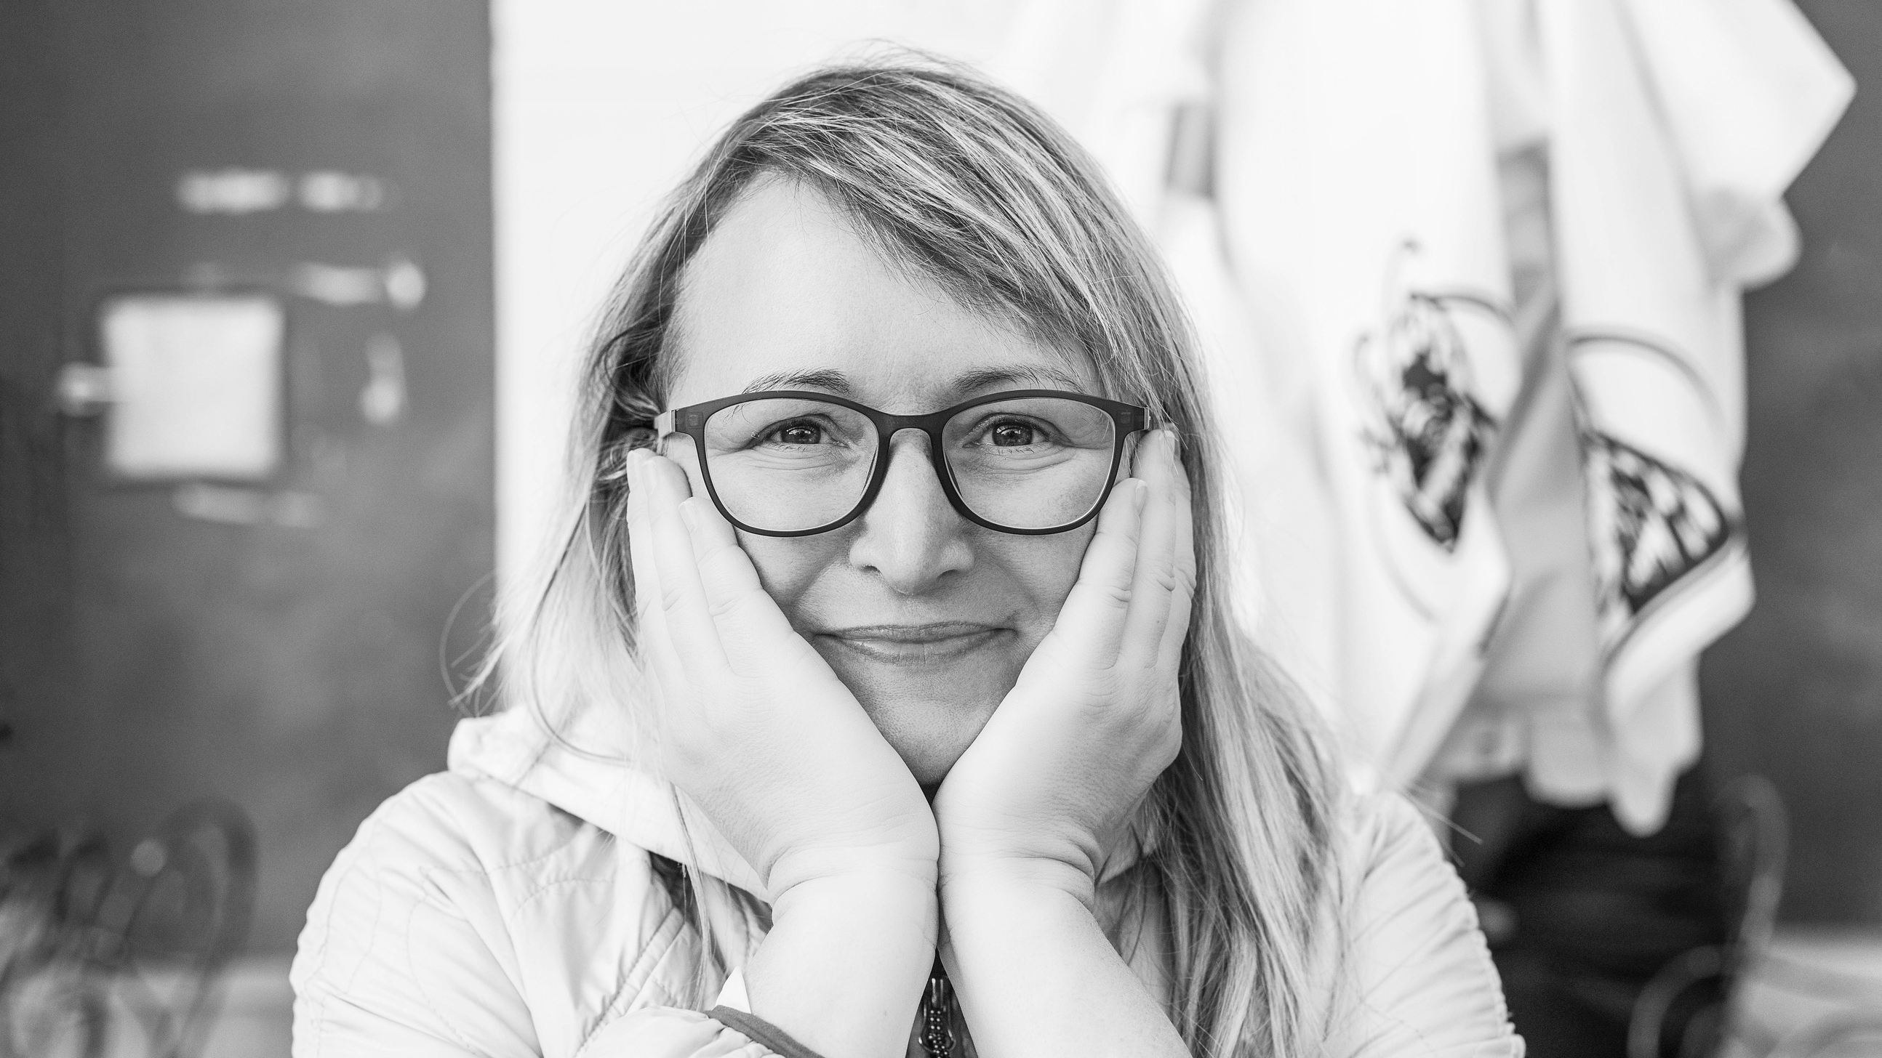
linktr.ee/jasnaio
LINKEDIN
MEDIUM
Notes:
Don't forget to connect with me on LinkedIn and follow me on Medium.
I'm looking forward to meeting you at any workshops or at the future cohorts of Master Digital Relationship-Building on Maven.
And you're invited also to any #LinkedInLocal events that we will host online.

